Slide 1
Quick summary on Chemspeed data extraction

Slide 2
Types of data: One perspective
Input data – imported into Autosuite to control the app file (Chemspeed custom run file; *.txt or *.csv) and give intended values for the system (e.g., weights or volumes)
Output data from app during run (Results text file) – the user can define variables (e.g. a timestamp where a plate begins to heat; where the app is in the process), and then output the values AUTOMATICALLY to monitor the run or to obtain important values that are hard to dig out any other way
Output data from the logfile (*.xlsx or *.csv) – the logfile is outputted at the end of a run (app finishes). This can then be analyzed (data exported) MANUALLY using the Chemspeed Excel Extractor program.

Slide 3
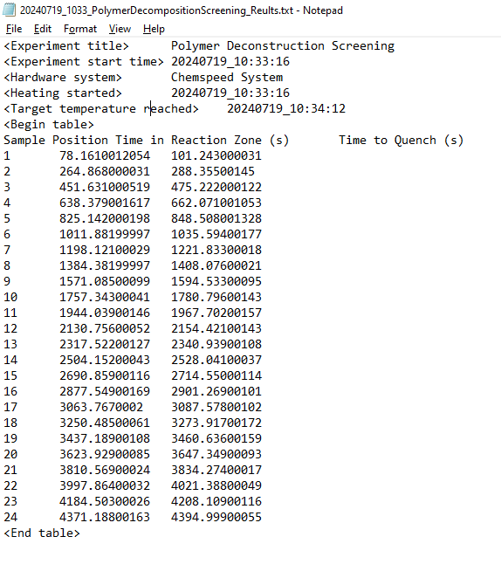
Custom Results File
This is an example of a file we could export from an app file during a run.
Each line is a single custom export.
I’ve added in manually the <> tags, which we could use to make the input files more flexible.
Each line in the table related to pulling a sample vial off of the heater. The “Time in Reaction Zone” is how long the sample was heating/reacting, and the “Time to quench” reflects the time to move the sample off the heater and then add methanol (to quench the reaction). The exact time is when all of the methanol has been added.

Slide 4
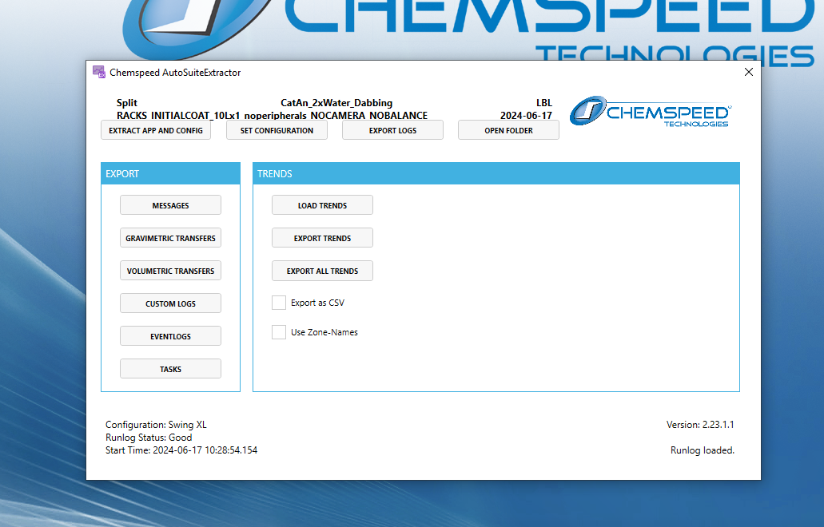
Autosuite Excel Data Extractor Program
You can export:
Specific messages or values (e.g., weights or volumes)
Trends in the metadata (e.g., hotplate temperature versus time)
The app information and configuration information (i.e., what hardware was used)
3
1
2

Slide 5
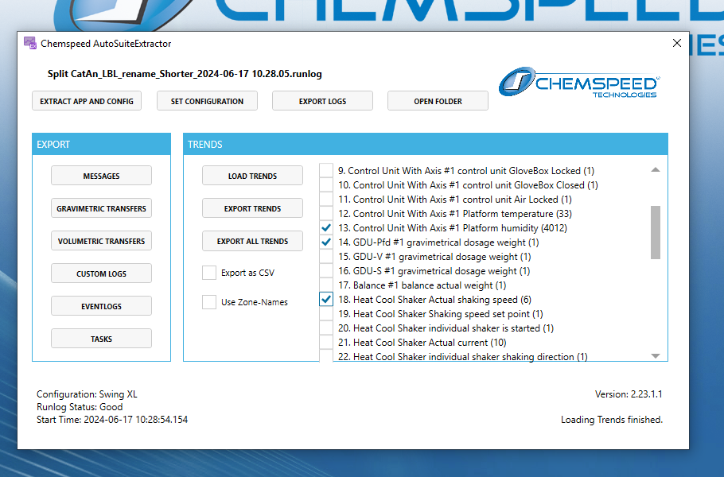
You can export all trends (yellow box) or just select some trends (blue box). This will export all data associated with a selected dataset.
For #13, the “Control unit… perform humidity” it has 4012 data points.
For #9-11, and #14-17, there is actually no data, just a timestamp when it was initialized.
Trends will all have timestamps, and others will have some other values (e.g., rpm, mass, etc.).
All trend data
Selected trend data

Slide 6
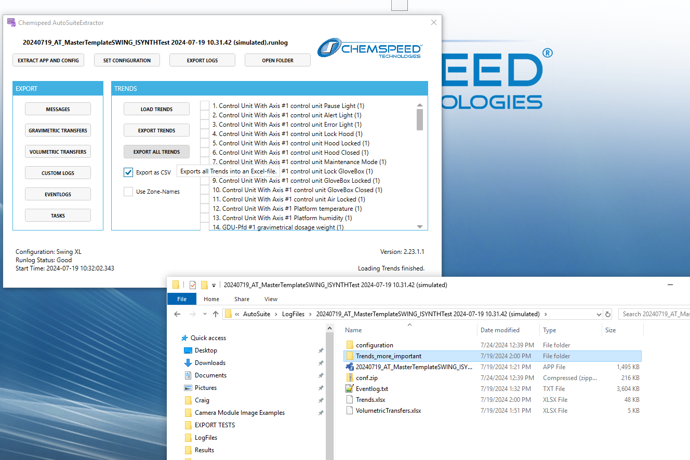
Export data can be *.xlsx, or *.csv if the check box is selected.
In this example there is volumetric data, but no gravimetric transfers.
Trends folder
“Export” volumetric transfers. Not trend data.

Slide 7
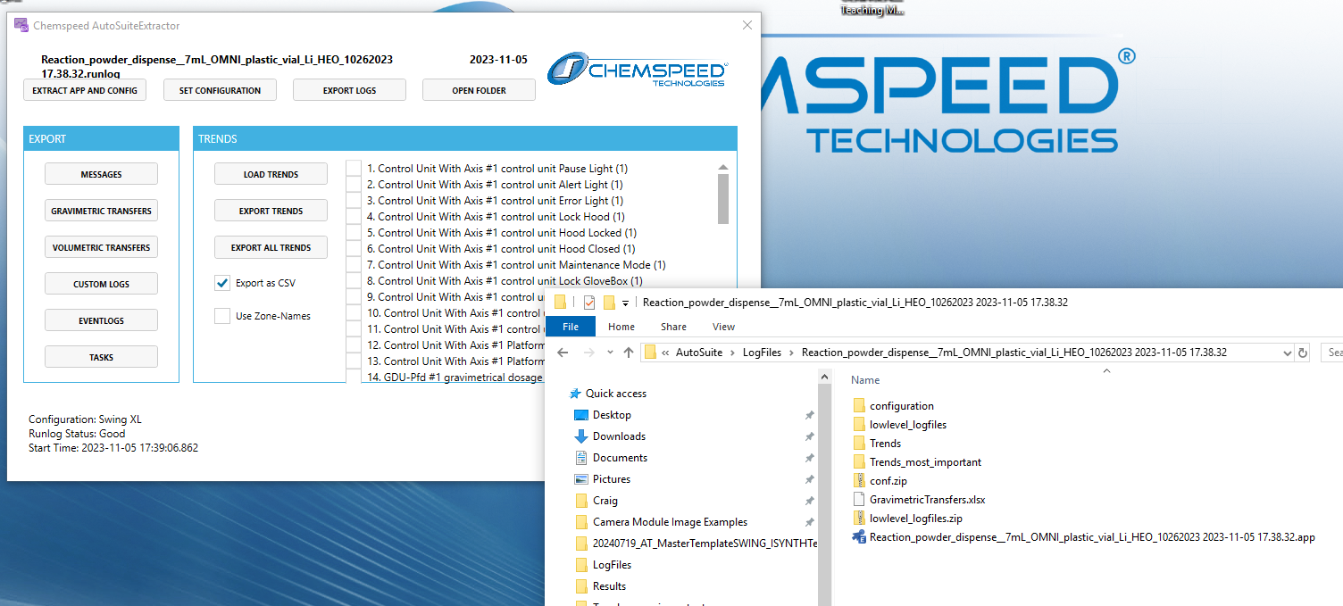
In this example there is no volumetric data, only gravimetric transfers.

Slide 8
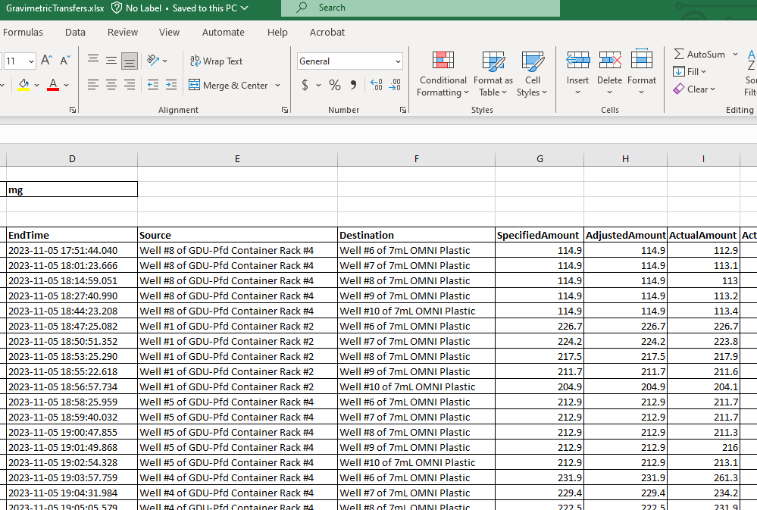
Example File from Excel Data Extractor Program
The gravimetric data export from the last slide contains this format. Note that the input data (specified amount) is given, as well as the “ActualAmount”, which is what the balance measured that it dispensed. You can see a difference because there is a tolerance of maybe 1-2 mg on the dispense. The difference can be higher in some cases anyway.
Source: the location of the container of precursor powder
Destination: where the precursor powder was dispensed into (usually into a vial for a reaction)

